Slide 1
QXU4004 Engineering Chemistry
Dr Sulafudin Vukusic
s.vukusic@qmul.ac.uk
1

Slide 2
QXU4004 Engineering Chemistry
Alkenes; Addition and Elimination reactions
Suggested Reading List:
Chapters 7 and 8: “Organic Chemistry” by Francis
A. Carey & Robert M. Giuliano (10th Edition, McGraw-Hill Education, 2017).
3

Slide 3
Revision:
Please revise your notes on condensed and skeletal (Line) Structures
Please revise your notes on sp² hybridisation and π
bonds, which are essential for this topic.

Slide 4

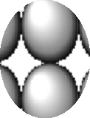

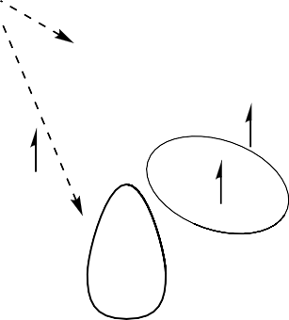







sp² Hybridisation
A second C geometry can be obtained by part hybridisation, i.e. mixing of the 2s, 2p_{x}, 2p_{y,} but not the2p_{z}
This gives 3 new equivalent hybrid orbitals, in a planer geometry, but leaves the 2p_{z} unhybridised
Each orbital has 1 electron, including the p_{z}
2s
2p_{x} 2
1s
2p_{z}
sp² sp² sp²
1s
sp² hybridised C-atom

Slide 5




















C_{sp2}-H and -C σ bonds
sp² hybrids have a shape similar to the sp³ (a little more ‘rounded’) but are oriented towards the corners of a triangle; trigonal or planar geometry
As for methane, the sp² hybrids can overlap with H 1s, C sp² (or C sp³) to give C-H and/or C-C σ MO (or σ bonds)

Slide 6



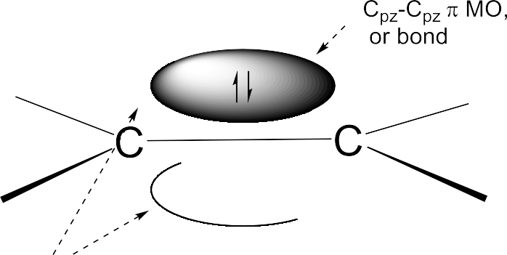

C_{sp2}-C_{sp2} π bonds
Sideways overlap of the unhybridised p_{z} AOs gives a C-C π MO (or π bond)
This contains the last two electrons and is both above and below the plane
Note: Again, do not worry if the shapes are not identical to other pictures or differently coloured. It is the general concept (orbital density between atoms for bonding.) that is important here

Slide 7
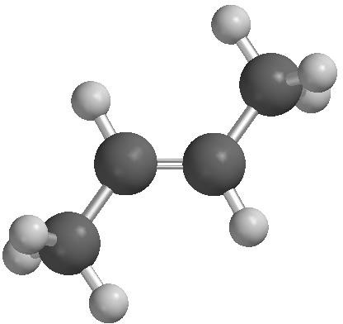
Isomerism
Preparations
Alkenes

Slide 8




Alkene isomerism
The restricted rotation about the C=C results in a form of diastereo- isomerism, often called geometric isomerism
1,2-disubstituted alkene isomers are often denoted by cis and trans
CURIOUS FACT
E comes from the German word entgegen = opposite
Z comes from the German word zusammen = together

Slide 9






Alkene isomerism
The restricted rotation about the C=C results in a form of diastereo- isomerism, often called geometric isomerism
1,2-disubstituted alkene isomers are often denoted by cis and trans
For tri, tetra-susbtituted, and (nowadays) for di-substituted, the (E),(Z) system is used

Slide 10





Alkene preparations
Alkenes can be prepared by elimination from alkyl halides or alcohols (see further on these notes)
（A principle:The more substitution,the more stable .）
Or from aldehydes or ketones via the Wittig reaction (we will not see this reaction in this course)
Section 18.12: “Organic Chemistry”
Strong acid.Not HCl,HBr

Slide 11
Addition Reactions
Electrophilic(亲电子的) reactions. Addition reactions that proceed via carbocations（碳正离子）.
Hydrogenation reactions. Addition of Hydrogen.
Oxidation reactions. Addition of Oxygen.

Slide 12














Reactions: electrophilic addition（亲电加成） of H-X
The general reaction is with E^{δ+}-X^{δ-}
Most common is H^{δ+}-X^{δ-}
‘X’ can be many groups, but the simplest is halogen

Slide 13






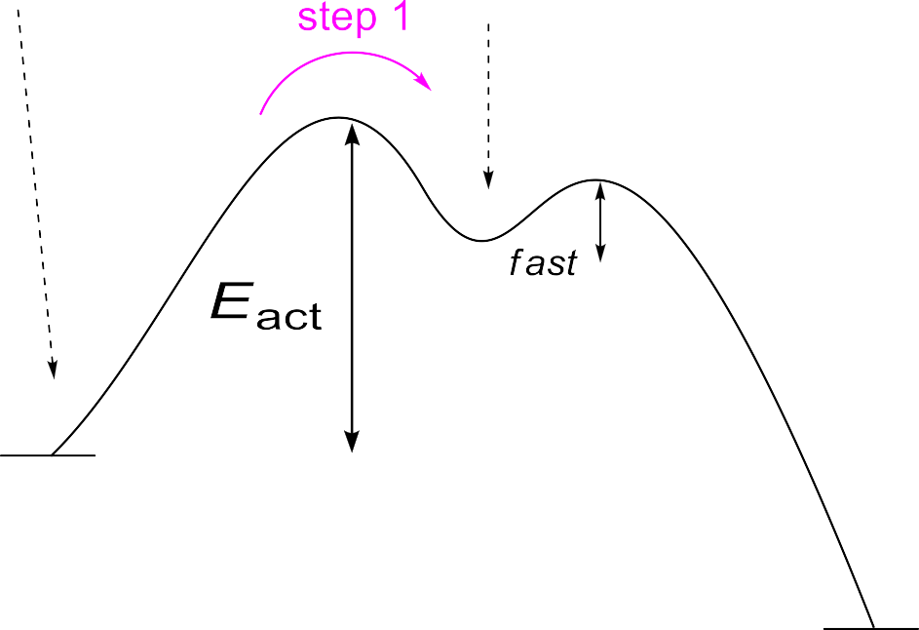
Mechanism of electrophilic addition
Step 1
Step 2
The mechanism is a two-step addition: first H⁺ to form a carbenium ion (carbocation) intermediate, followed by X⁻ to yield（产出的） product
The slow (rate-limiting) step is the first one
Reactivity can be explained by considering the formation of the carbenium ion.

Slide 14









Alkenes: orientation（定位，方向） of addition
• In the example there are two possible regiochemistries of addition (regiochemistry: the possibility of reactions to lead to different structural isomers: in the example above which of the two possible C will the Cl form a bond to?)
• Addition of H to the 'less substituted' C of C=C, (-Cl to the 'more substituted‘), is an empirical rule
(MARKOVNIKOV'S Rule)

Slide 15


Alkenes: orientation of addition
• In the example there are two possible regiochemistries of addition (regiochemistry: the possibility of reactions to lead to different structural isomers: in the example above which of the two possible C will the Cl form a bond to?)
• Addition of H to the 'less substituted' C of C=C, (-Cl to the 'more substituted‘), is an empirical rule
(MARKOVNIKOV'S Rule)

Slide 16
Alkenes: orientation of addition
CH₃
H C C CH₃
H
H
^{E}act ^{1o}
energy
Eact ^{3o}
CH₃ C
It can be rationalised by considering which of the two possible intermediate
carbenium ions will more readily form.
Since the 3º carbenium ion forms more readily (it is more stable), the product
derived from this (2-chloromethylpropane) is favoured

Slide 17

Carbenium ion/carbocation stability
Remember, the carbenium ion is a high energy intermediate carbocation
However, alkyl groups are weakly ‘electron-donating’ (electronic effect, this is an electronegativity
type of effect, which some books call “inductive effect” to differentiate it from “resonance effect”)
So alkyl groups R (but not H) attached to the C⁺ lower its energy slightly (stabilise it)

Slide 18




Carbenium ion/carbocation stability
The order of alkyl carbenium ion stability (i.e. ease of formation) is as shown
Remember (from earlier) that resonance- delocalised carbenium ions are also stabilised
If these are included, the order is as shown

Slide 19







Reactions: electrophilic addition of H₃O⁺ (hydration)
By analogy with H-X, water (H-OH) adds ‘H’ to one side and ‘OH’ to the other
But the H of H-OH is not sufficiently polarised
So, H⁺ is added as catalyst, usually from H₂SO₄ or H₃PO₄
35

Slide 20





Mechanism of hydration（水化）
Step 1
Step 2
Deprotonation
The mechanism involves a two-step addition: first H⁺ to form a carbenium ion/carbocation (Step 1) followed by H₂O to yield product (Step 2)
The initial product is a ‘protonated’ alcohol and looses H⁺ (deprotonation)
The reaction is reversible in all steps so is NOT a great method for converting
alkenes to alcohols
36

Slide 21
Mechanism of hydration
Other nucleophiles in the mix may attack the carbenium ion
This is why aqueous HCl (hydrochloric acid) is not used here
Bisulphate (HSO ⁻) and
4
sulphate (SO ²⁻) are poor
4
nucleophiles so only compete
in conc. acid conditions
37

Slide 22
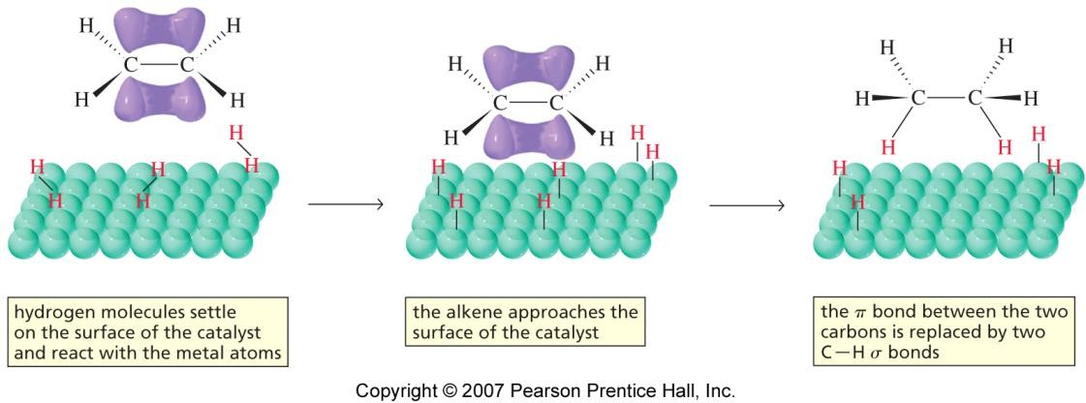
Alkenes: hydrogenation
Alkenes do not add H₂ without a catalyst, e.g. palladium (Pd) dispersed on charcoal (Pd/C), platinum oxide (PtO₂) and Raney Nickel (Ni)
H₂ is activated on the surface of the catalyst and adds in a syn mode (both H from the same side)
These catalysts will also hydrogenate (reduce) other π-bond-containing functional groups (NO₂ > C=O ~ C=C > CN > Ar)

Slide 23
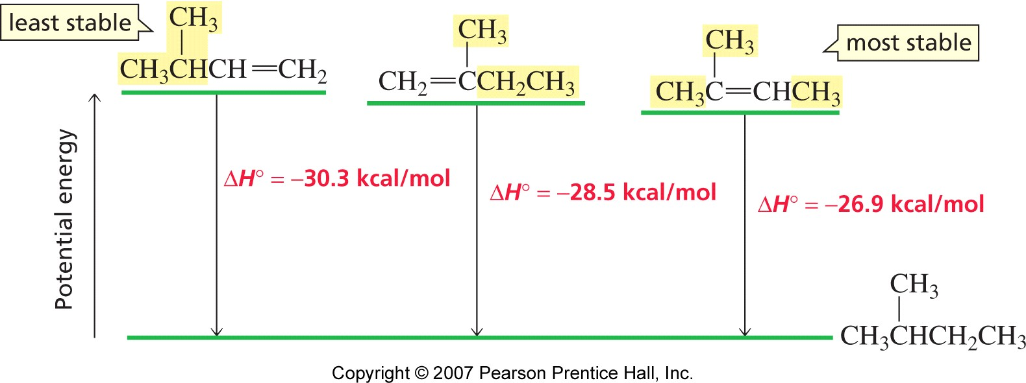

Hydrogenation and alkene stability
An alkane is more stable (lower energy of formation) than alkene + H₂
Isomeric alkenes can hydrogenate to the same alkane
So, the heat of hydrogenation allows the relative stabilities of alkenes to be determined

Slide 24












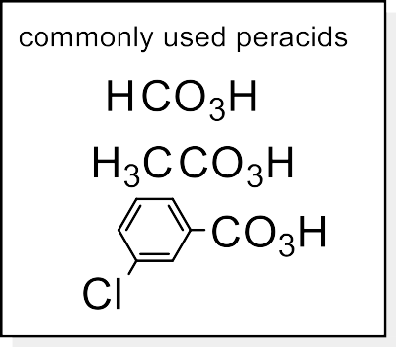
Reactions: oxidation
Vigorous treatment with acidic dichromate (Na₂Cr₂O₇) or acidic permanganate (KMnO₄) breaks both the π-bond and the σ-bond to give a C=O at each terminus
Gentler oxidation using OsO₄ gives a cis-diol
Use of a peracid （过酸）(also “peroxy-
acid”) gives an epoxide（环氧化物）

Slide 25
Elimination Reactions（消去反应）
Elimination E2. Concerted process, single step mechanism.
Elimination E1. Two step reaction via carbocation intermediate.
Elimination E1Cb. Less common mechanism via carbanion intermediate.

Slide 26







Alkene preparations
Alkenes can be prepared by elimination from alkyl halides（）卤代烃 or alcohols

Slide 27


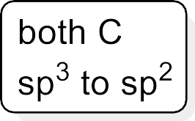





Elimination
The elements of H-X can be eliminated by a good base (in Organic Chemistry we usually use the term “base” to signify forming a bond with “H⁺”, even if we know from our understanding of Lewis Acids and Bases, that the term is broader.
This is the reverse of electrophilic addition（亲电子加成） to alkene
A base may often act as a nucleophile (nucleophile is usually in Organic Chemistry restricted to reacting with C)
Another distinction is that nucleophile is a term used for describing kinetic behaviour, while base is more
restricted to thermodynamics

Slide 28


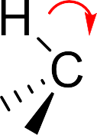
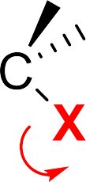
Mechanism: elimination E2
Mechanism explained (follow the red arrows)….
The base uses its 2e⁻ lone pair to form a new bond to H …
while the 2e⁻ in the H-C σ-bond move between the C-C to form a π-bond (double
bond)…
while the 2e⁻ C-X σ-bond moves onto the X as a new lone pair
BUT this is concerted（协调一致的）, i.e. all occurring simultaneously.
E2: it is a single step, but the overall order of the reaction is 2

Slide 29
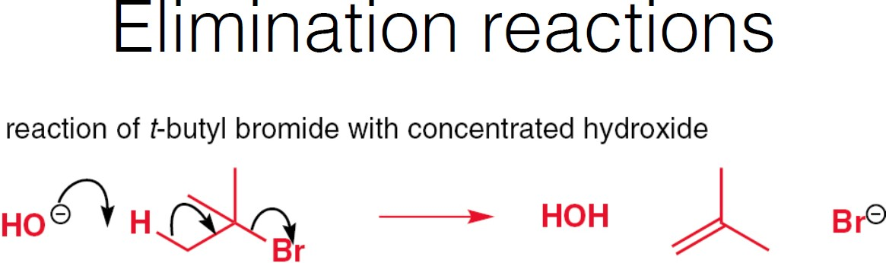
Example elimination E2. Favoured with a strongly basic nucleophile as OH⁻.

Slide 30











Elimination: E2 kinetics and Transition State (TS)
In the TS the B---H bond is part-formed, the C---X bond is part-broken; B has δ⁺ and X has δ⁻; there is a part
π-bond between the C’s
Being a simple collision between B and RX, the kinetic rate equation is as shown (bimolecular); this is an E2
mechanism

Slide 31







E2 reactivity
The TS has a partial double bond, so is a pseudo-alkene
The ease of reaching the TS is determined by the stability (lower energy) of this pseudo alkene
So, E2 reactivity parallels alkene stability
Reactivity order is 3º > 2º > 1º

Slide 32







E2 regioselectivity（区域选择性）
For the same reason, where there is a choice within the same molecule E2 TS, the more stable (lower energy) E2 TS is preferred
Therefore, the more stable alkene product is formed
Such constitutional isomers (e.g. but-2-ene vs. but-1-ene) are often called regioisomers; the preference for one is
called regioselectivity
52

Slide 33




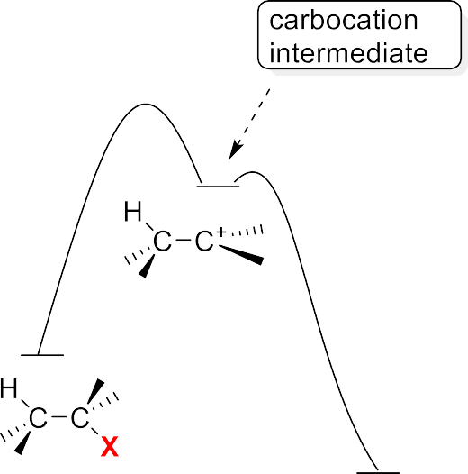




E1 kinetics and mechanism
An E1 mechanism is also possible
As with S_{N}1, the first and rate- limiting step (rls), is formation of a carbenium ion
If the base/nucleophile removes a β-H instead of adding to the C⁺, an alkene results

Slide 34











E1 reactivity, regioselectivity, S_{N}1
Reactivity parallels S_{N}1 (3º > 2º > 1º) (same r-l-s)
More substituted C=C preferred in product
Since E1 and S_{N}1 share a common intermediate and transition state, they often occur in the same reaction

Slide 35












Elimination of alcohols
Under acidic conditions without a nucleophile
present alcohols can undergo E1
As usual, E1 is favoured by 3º and 2º alcohols
1º alcohols require high temperatures
The leaving group is –O⁺H₂
H₂SO₄ or H₃PO₄ are used, having non- nucleophilic conjugate bases (so S_{N}1 is minimised)
E2 is not easy for any alcohol

Slide 36
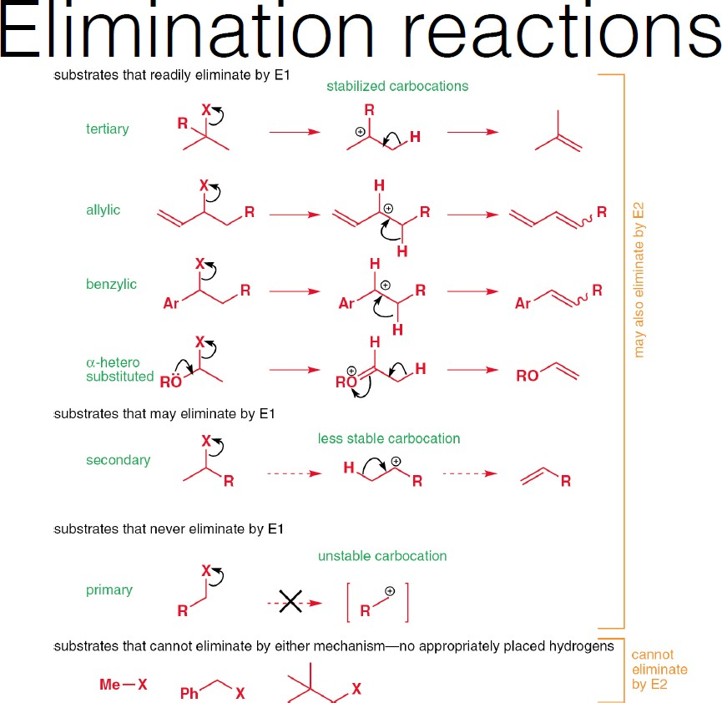
Notes:
消去反应E1E2

Slide 37
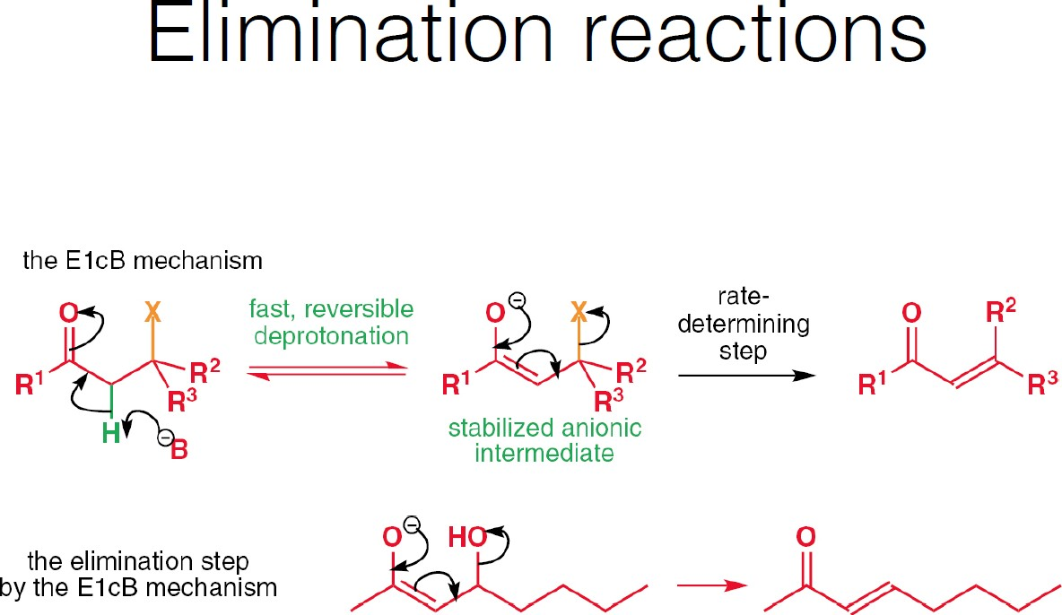
E1cB: a less common mechanism

Slide 38














S_{N} and E for other leaving groups
In general, the same type of S_{N}2, S_{N}1, E2 and E1 reactions are possible for any C-X
X is the leaving group
Other leaving groups are X = halogen, or X = -O-R, -NHR
R is often a larger group, often electron-withdrawing

Slide 39
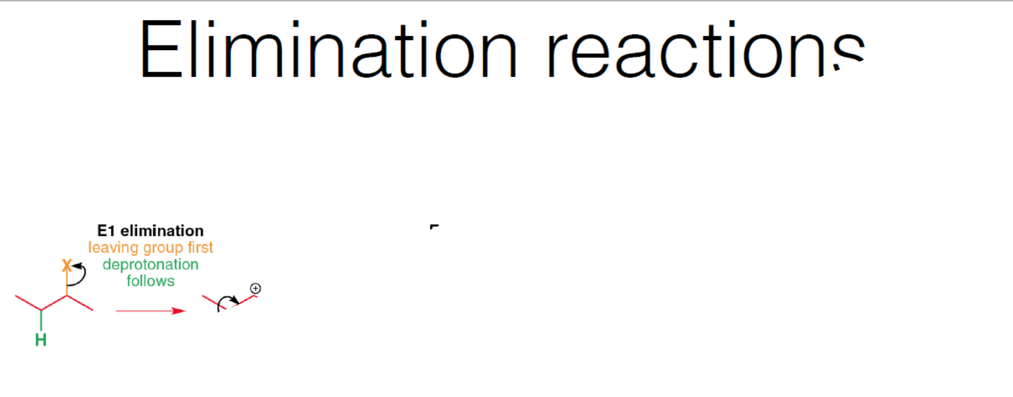
E1: favoured in acidic media or weakly basic E2: favoured in strongly basic media
E1cB: favoured in strongly basic media but carbanion (negative charge on C) is stabilised so an intermediate can form
62

Slide 40
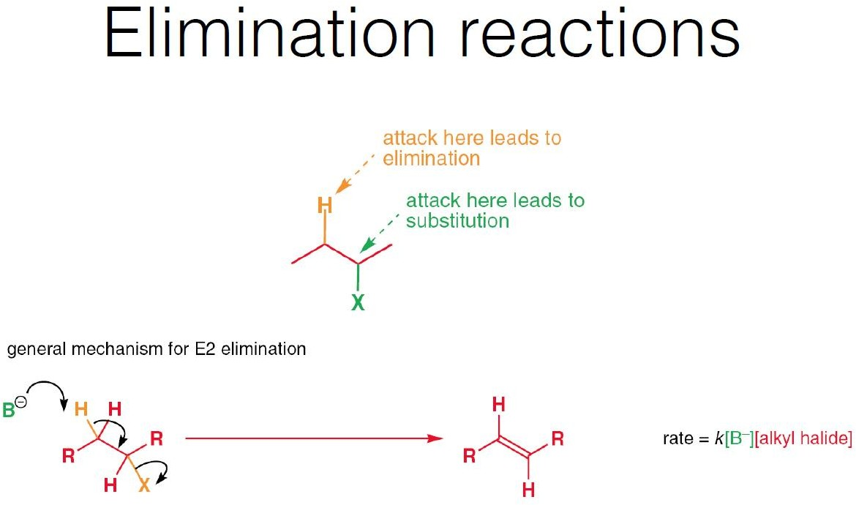

Slide 41
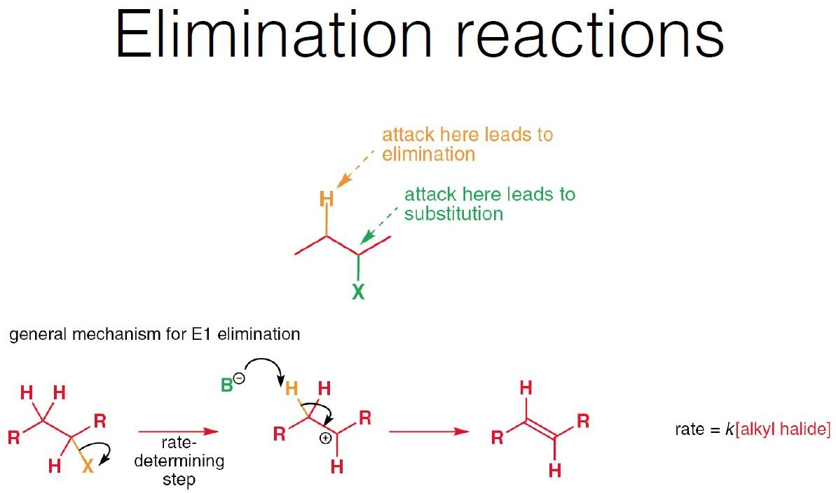

Slide 42
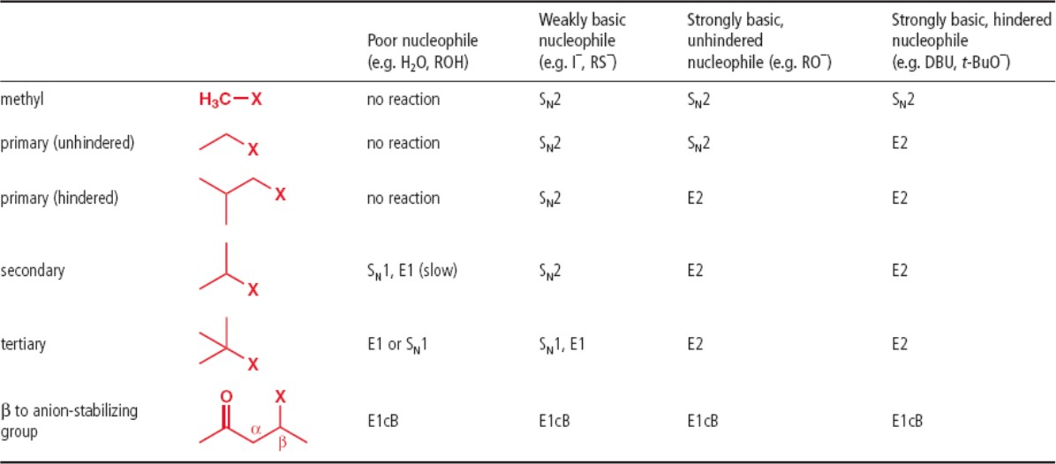
zS_{N} vs E:
S_{N} vs E: in reality these reactions always compete, leading in some cases to mixtures of products.
For the purpose of the course assessment, you would normally get situations which are extremely clear to distinguish
(such as strong but sterically hindered base, or good nucleophile but poor base: we will discuss this in class)
65
Notes:
Sn vs E

